Slide 1
Unit 2 - Lecture 10
Hill climbing search
Local maxima

Slide 2
Hill climbing search
If our heuristic function is good then perhaps we can rely on it to drive the search to the goal.
We modify the way OPEN is updated in Best First Search.
OPEN <— append (sort_{h} (NEW, tail(OPEN)))
we can try using
OPEN <— sort_{h} (NEW), where, NEW is the list of new successors of the nodes just expanded.
Observe that in doing so we have discarded the nodes that were added to OPEN earlier.
We have burned our bridges as we move forward.
A direct consequence of this will be that the new algorithm may not be complete.

Slide 3
But having done this, we might as well not maintain an OPEN list, since only the best node from the successors will be visited.
The revised algorithm is given here:
Hillclimbing()
node <- start
newNode <- Head(sort_{h}(MoveGen(node)))
while h(newNode) < h(node)
do node <- newNode
newNode <- Head(sort_{h}(MoveGen(node)))
return newNode
Observe that this algorithm has modified our problem solving strategy considerably.

Slide 4
In the search algorithms we saw till now, the termination criterion was finding the goal node.
In Hill Climbing, the termination criterion is when no successor of the node has a better heuristic value.
Searching for the goal has been replaced with optimizing the heuristic value.
The problem has been transformed into an optimization problem, in which we seek the node with the lowest heuristic value, rather than one that satisfies the goalTest function.
This is consistent with the notion that the goal state has the lowest heuristic value, since the distance to the goal is zero.
Let us consider the negation of the heuristic function —h(n).

Slide 5
Instead of looking for lower values of h(n), we can equivalently say that we are looking for higher values of —h(n).
That is, instead of a minimization problem, we have a maximization problem.
As long as the moveGen function keeps generating nodes with better (higher) values, the search keeps stepping forward.
Of the choices available, the algorithm picks the best one.
Imagine you were blindfolded and left on a hillside, and asked to go to the top.
What would your strategy be? Presumably, you might test the ground on all sides and take a step in the direction of the steepest gradient.

Slide 6
And you would stop when the terrain in no direction is going upwards.
That is precisely what the algorithm Hill Climbing is doing; moving along the steepest gradient of a terrain defined by the heuristic function.
The idea is illustrated in Figure in next slide.
Observe that while the "terrain" is defined by the heuristic function, and different heuristic functions define different "landscapes", it is the moveGen function that independently determines the neighborhood available to the search function.
The moveGen function determines the set of points, both in number and location, in the landscape that become the neighbors of a given node.

Slide 8
The heuristic function assigns a heuristic value to each point supplied by the moveGen function.
The problem with climbing hills blindfolded is that one does not have a global view.
We can only do local moves, and the best we can do is to choose the locally good options.
If the hill we are asked to climb had a "smooth" surface then the algorithm will work well.
However, mountainous terrain is rarely smooth, and one is more likely than not to end up in the situation depicted in next slide figure .
Instead of reaching the highest peak, we might end up in a lower peak somewhere on the way.

Slide 9
In other words, one has reached a maximum, but only one that is local.
If the heuristic function used by Hill Climbing is not perfect then the algorithm might well find a local maximum as opposed to a global maximum.

Slide 10
Local maxima
We look at an example problem where the choice of a heuristic function determines whether there are local maxima in the state space or not.
The blocks world domain consists of a set of blocks on an infinitely large table.
There can be only one block on top of each block.
The problem is to find a sequence of moves to rearrange a set of blocks, assuming that one can only lift the topmost block from a pile, or keep a block only on the top of a pile.
That is, each pile of blocks behaves like a stack data structure.
The figure in next slide illustrates a sample problem.

Slide 11
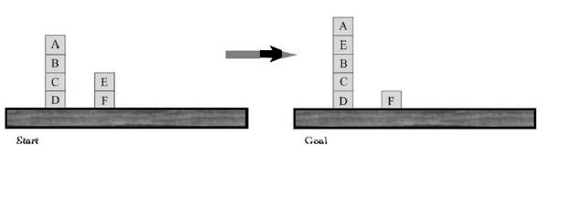

Slide 12
In the initial state, four moves are possible as shown in figure in next slide
Either block A can be moved, or block E can be moved.
The destination is either the other pile or the table.
Let us see how two different heuristic functions guide our Hill Climbing search algorithm.
The two functions differ in the level of detail they look at in a given state.
The first function h₁(n) simply checks whether each block is on the correct block, with respect to the final configuration.
We add one for every block that is on the block it is supposed to be on, and subtract one for every one that is on a wrong one.

Slide 13
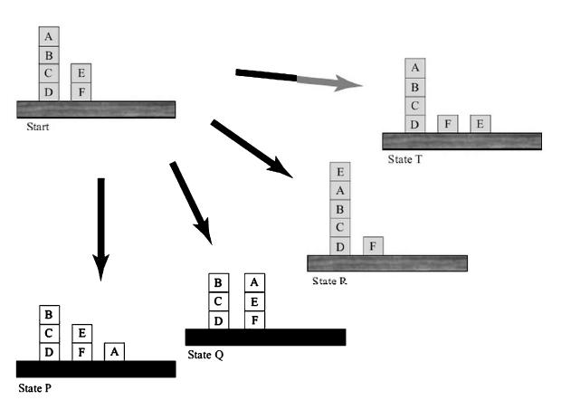

Slide 14
The value of the goal node will be 6.
Observe that the heuristic function is not an estimate of the distance to the goal, but a measure of how much of the goal has been achieved.
With such a function we are looking for higher values of the heuristic function.
That is, the algorithm is performing steepest gradient ascent.
For the five states, S (start) and its successors P, Q, R, and T, the values are
h1(S)=(-1)+1+1+1+(-1)+1=2
h1(P)=(-1)+1+1+1+(-1)+1=2
h1(Q)= 1 +1 +1 +1 + (-1)+1= 4
h1(R)=(-1)+1+1+1+(-1)+1=2
h1(T)=(-1)+1 +1+1 +(-1)+1=2

Slide 15
where, h1(n)= valA + valB + valC + valD+ valE + valF
Clearly h1 thinks that moving to state Q is the best idea, because in that state, block A is on block E.
The second heuristic function looks at the entire pile that the block is resting on.
If the configuration of the pile is correct, with respect to the goal, it adds one for every block in the pile, or else it subtracts one for every block in that pile.
The values for the six nodes we have seen are

Slide 16
h2(S)= (-3) + 2 + 1 + 0 + (-1) + 0 = -1
h2(G) = 4 + 2 + 1 + 0 + 3 + 0 = 10
h2(P) = 0 + 2 + 1 + 0 + (-1) + 0 = 2
h2(Q) = (-2) + 2 + 1 + 0 + (-1) + 0 = 0
h2(R)= (-3) + 2 + 1 +0+ (-4)+0=-4
h2(T) = (-3) + 2 + 1 + 0 + 0 + 0 = 0 =0
The first thing to notice is that the heuristic function h2(n) is much more discriminating.
Its evaluation for almost all nodes is different.
The second is that its choice of the move is different.
It thinks that moving to state (node) P is the best.
It is not tempted into putting block A onto block E.

Slide 17
In both cases, since there is a successor with a better heuristic value, the Hill Climbing algorithm will make a move.
Let us look at the second move.
In the first case, for h₁ the algorithm is faced with the following choices for the second move, shown in figure in next slide.
We have named the states P and Start the same, though the search will see them as new choices.

Slide 18
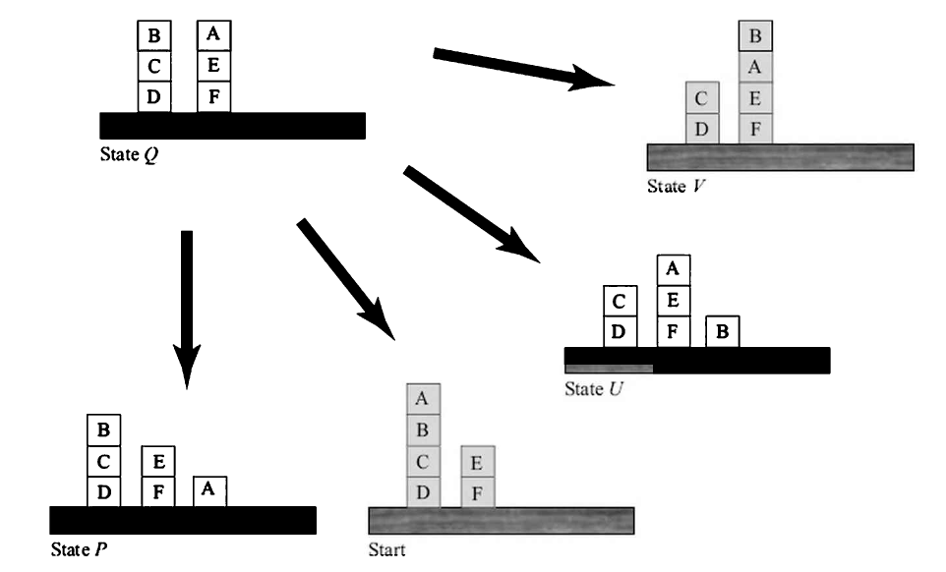

Slide 19
The heuristic values of the possible moves are given below.
Search is at node Q, and all choices have a lower heuristic value.
Thus, Q is a local maximum, and Hill Climbing terminates.
h1(Q)= 1 + 1 + 1 + 1 +(-1)+ 1 =4
h1(P)= (-1)+ 1 + 1 + 1 +(-1)+ 1 =2
h1(S)= (-1)+ 1 + 1 + 1 +(-1)+ 1 =2
h1(U)= 1 +(-1)+ 1 + 1 +(-1)+ 1 =2
h1(V)= 1 +(-1)+ 1 +1 +(-1)+ 1 =2
Meanwhile, the choices faced by the search using the second heuristic function h2, from state P, are shown in figure in next slide.

Slide 20
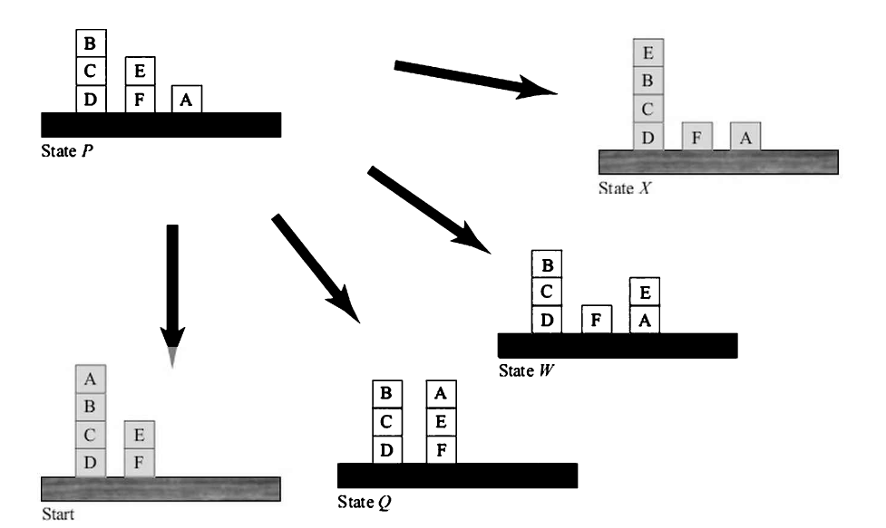

Slide 21
Like in the previous case, two of the four choices result in states seen earlier.
The heuristic values are
h2(P)= 0+ 2 + 1 +0 +(-1)+0 =2
h2(S)= (-3)+ 2 + 1 + +(-1)+0 =-1
h2(Q)= (-2)+2+1+0+(-1)+0 =0
h2(W)= 0+2+1+0+(-1)+0 =2
h2(X)= 0+2+1+0+3+0 =6
The search has a better option available in state X and moves to it.
The reader can verify that in the next move it will reach the goal state.

Slide 22
The performance of the Hill Climbing algorithm depends upon the heuristic function chosen.
One can think of the heuristic function defining a terrain over the search space, with each state having a heuristic value.
While the strategy remains the same, that is the steepest gradient ascent (or descent, if the heuristic function is such that lower values are better), the performance depends upon the nature of the terrain being defined, as illustrated in figure in next slide.
If the heuristic function defines a smooth terrain, the search will proceed unhindered.
On the other hand, if the terrain is rolling then the search could get stuck on a local optimum.

Slide 23
